Slide 1
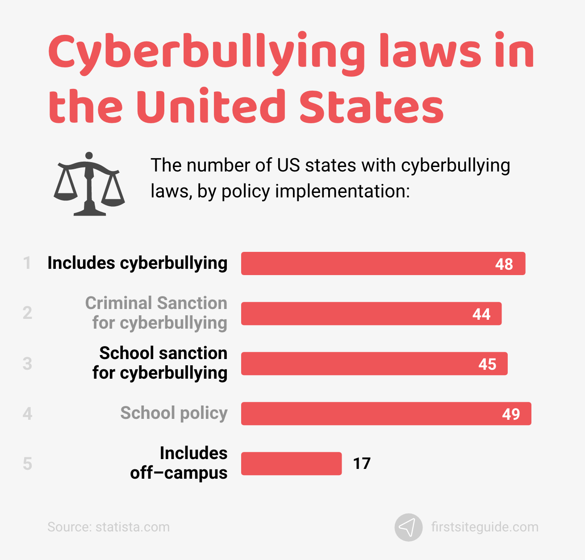
Global Perspectives on Cyberbullying

Slide 2


UNODC announced an international law.
Referred as an interpersonal cybercrime.
Punishment may vary depending on the severity
Three laws against it in Bangladesh
ICT Act 2016 and Digital security act 2018
Punishment can be up to imprisonment

